Slide 1
Tracking the evolution of pathogens over time
Site and clock models in phylogenetics

Slide 2
The spread of pathogens between hosts over time can be described using a phylogenetic tree.
Notes:
* Phylogenetic trees capture past transmission dynamics
* Each lineages in a tree corresponds to a pathogen in a host

Slide 3
When pathogens are replicated, random errors occur, some of which will rise to fixation.
Notes:
* During replication of pathogens, random errors occur, some of which increase fitness, some of which do nothing and most of which have a negative impact
* These random error happen at a rate that is given by the mutation rate
* Over time, random error accumulate

Slide 4
We can access some of this information by sequencing pathogens at the “tips” of phylogenetic trees.
Notes:
If we then go and sequence pathogens isolated from different individuals, the sequence data will look differently depending on how far apart in the transmission history they are
The further apart in the transmission history, the more diverged the genetic sequence data will be.
Additional to the genomic sequences, we often know when a sample was isolated from a patient.

Slide 5
This results in the data we typically have, i.e. a sequence alignment and the information when a sequence was isolated from a patient.
Notes:
* The genetic sequence data and sample isolation time constitute the data in our later models and are typically in the form of a multiple sequence alignment with sampling times.

Slide 6
Evolutionary models allow us to get from sequence alignments and sampling times to phylogenetic trees.
Notes:
We can then use mathematical models to get from a multiple sequence alignment and sampling times to an estimate of these sequences relate over time.
This relation over time is denoted by timed phylogenetic trees.

Slide 7
Notes:
To get from a multiple sequence alignment to a timed phylogenetic trees, we use evolutionary models that are often split into two parts.
The Site model tells us how we can get from a multiple sequence alignment (without using sampling times) to a divergence tree.
This divergence tree has a branch length genetic distance.
To get from a divergence tree to a tree where the branch lengths and node heights are in actual time, we use clock models.
Clock models are essentially mathematical functions to map genetic distance into time.

Slide 8
Getting from multiple sequence alignments to time tree can be done using different approaches
MLE route: Uses programs such as RaxML (IQ-Tree etc.) to get a divergence tree. Programs such as Least Square Dating, Time Tree etc. then use this tree, add sampling times to get time trees.
Bayesian route: Jointly estimates the phylogenetic tree, how to map alignments to divergence and how to map this to actual time with a bunch of other parameters.

Slide 9
Site models describe the relative change across nucleotides and positions in the alignment and consist of several parts.
Substitution models describe how fast/slow the change from one to another nucleotide happens compared to others
Rate heterogeneity models describe how fast/slow some sites in an alignment change bases compared to others
Codon positions models allow for some codon positions to evolve faster/slower than others

Slide 10
Substitution models allow to account for differences in nucleotide substitution rates.
Rate Matrix
Base Frequencies
b
A
G
f
π_{A} + π_{C} + π_{G} + π_{T} = 1
d
c
C
T
e
JC
a=b=c=d=e=f
π_{A}=π_{C}=π_{G}=π_{T}
No I or G
0 free parameters
HKY
a=c=d=f, b=e
π_{A}, π_{C}, π_{G}, π_{T}
No I or G
4 free parameters
GTR
a, b, c, d, e, f
π_{A}, π_{C}, π_{G}, π_{T}
No I or G
8 free parameters
(slide from Sebastian Duchene)
Notes:
Substitution models tell us how to model the relative speed/rate of changes between nucleotides.
The simplest model (the Jukes cantor) assumes that all transitions between nucleotides (e.g. A->T, A-G…) happen equally fast. Additionally, it assumes that all bases occur equally often. The JC model requires 0 parameters to be estimates
The HKY model allows for transitions and transversions to happen at different relative rates and for nucleotides to occur at different relative frequencies. Transitions are nucleotide changes between chemically closely related nucleotides and transversions those between chemically more distantly related nucleotides. The prior assumption is that transitions are more likely than transversion. This model has 4 parameters to be estimated.
The GTR model allows all rates and nucleotide frequencies to differ and is typically the most complex substitutions model that is regularly used.
There is a vast amount of other substitution models between all of these, only few which are actually named.
All the models assume that rates of nucleotide changes are equally likely in both direction (resp. are symmetric).

Slide 11
Some site in the alignment might be more flexible and therefore evolve less quickly.
CTAT--GGCACCCAGCCCATGCAT-GGT
CTAA--GGCAACCAGCCCATACAT-GCT
CTATGTGGCAACCAGCCCATGCAT-GCT
ATATGTGGCAGCCAG-----GCATAGGT
ATATGTGGCAGCCAGCCCATGCATAGGT
Medium
Slow
Fast
(slide from Sebastian Duchene)
Notes:
Additional to accounting for changes between individual bases to occur at different speeds, we also have some positions in the alignment that are more or less likely to change.
This can e.g. be the case if the positions codes for an amino acid at a vital position in a protein that can’t be changed.
Other nucleotides might code for amino acids at positions that interact with the immune system etc.

Slide 12
Proportion of invariable sites account for sites that do not change (e.g., HKY+I).
1
Proportion of sites
1-P_{inv}
P_{inv}
0
Rate
(slide from Sebastian Duchene)
Notes:
Proportion of invariable sites accounts for positions in the alignment that can’t be changed, are fixed.
Estimating the proportion of invariants adds one parameter to an analysis and slows down the likelihood calculation by a factor of 2.

Slide 13
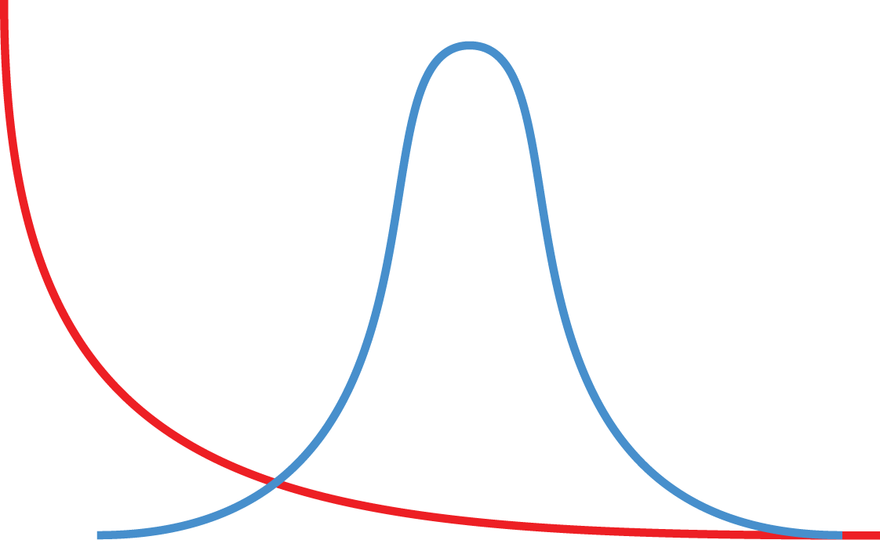
Gamma rate heterogeneity models account for rate differences across sites (e.g. HKY+G₄).
alpha=0.5
alpha=100
Proportion of sites
0
(slide from Sebastian Duchene)
Notes:
Gamma rates assume each sire evolves at a relative speed that is a draw from a gamma distribution.
The alpha value of this distribution is estimated during the MCMC.
The larger alpha, the bigger the difference in speed of evolution between individual site is.
To be computationally feasible, the gamma distribution is approximated by a discretized distribution, i.e. split into some number of gamma rate categories.
The number of categories is typically 4 or 5.Why? Because it works good enough

Slide 14
Changes in the third codon position are far more likely to not affect the amino acid
Splitting up the alignment into different codon positions and allow each having its own site model allows accounting for these differences
https://www.genomenon.com/codon-chart/
Notes:
Additional to those models, the reading frame is an important determinant of the speed of evolution.
The third codon position is typically substantially more flexible than the first two.
Nucleotide changes on the third positions are much less likely to lead to amino acid changes and or therefore more often synonymous and can be expected to occur much more often
Nucleotide changes on the first two positions, in turn, are much more likely to be non-synonymous
The way this is dealt with in the models is by splitting the alignment into different reading frames, to allow each one to have it’s of substitution and rate heterogeneity models as well as a different average rate of evolution.

Slide 15
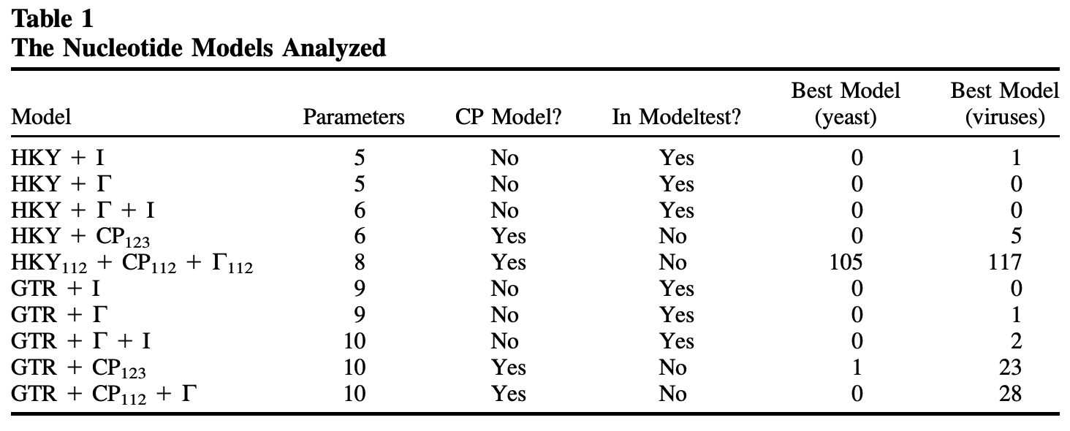
Accounting for rate variation between codon positions is almost always better
Shapiro et al., 2006, MBE
Notes:
* In almost all cases, models that account for reading frames are a better descriptor of the truth than those that are not.

Slide 16
Practical considerations
Everything affects everything in Bayesian phylogenetics. Wrong evolutionary models lead to wrong trees lead to wrong population parameters.
Overparameterization is better than under-parameterization. In doubt, use the more complex site model, such as a GTR+ model (Abadi et al., 2019, Nat. comm.)
Don’t forget to account for rate heterogeneity (experience). Also, the JC69 model is hardly ever appropriate.

Slide 17
QUESTIONS?

Slide 18
The molecular clock

Slide 19
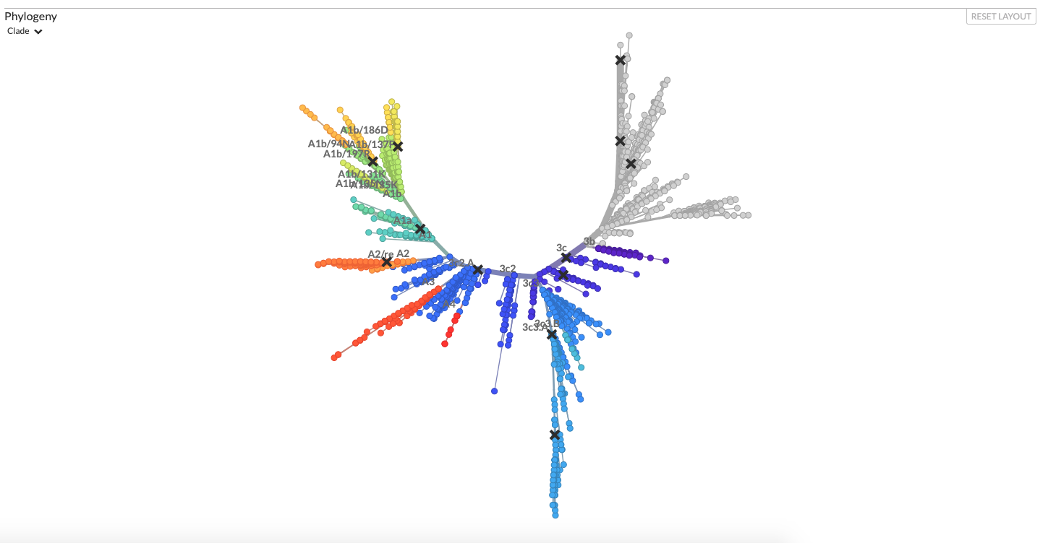
Using site models, we can get from alignments to divergence trees
nextstrain.com
Notes:
The site models gets us to divergence trees, where branch lengths are in genetic distance

Slide 20
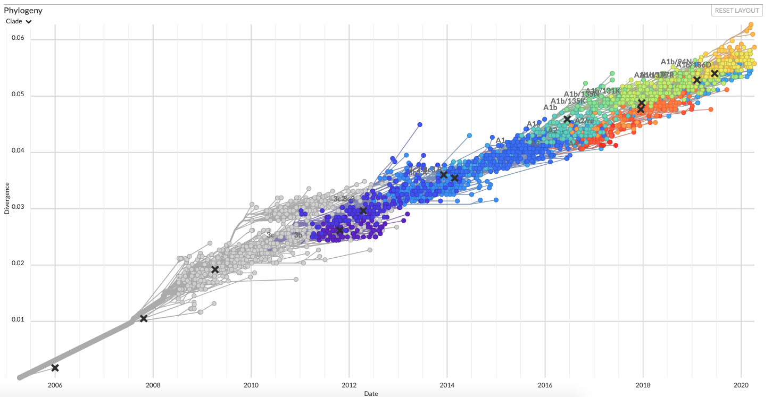
Sequences that are further apart in time are more diverged
nextstrain.com
Notes:
If we look at the divergence (on the y-axis) of sample taken over many years, this divergence accumulate over time in pretty much a linear fashion
This shows a direct relationship between time and divergence, which we can make use of.

Slide 21
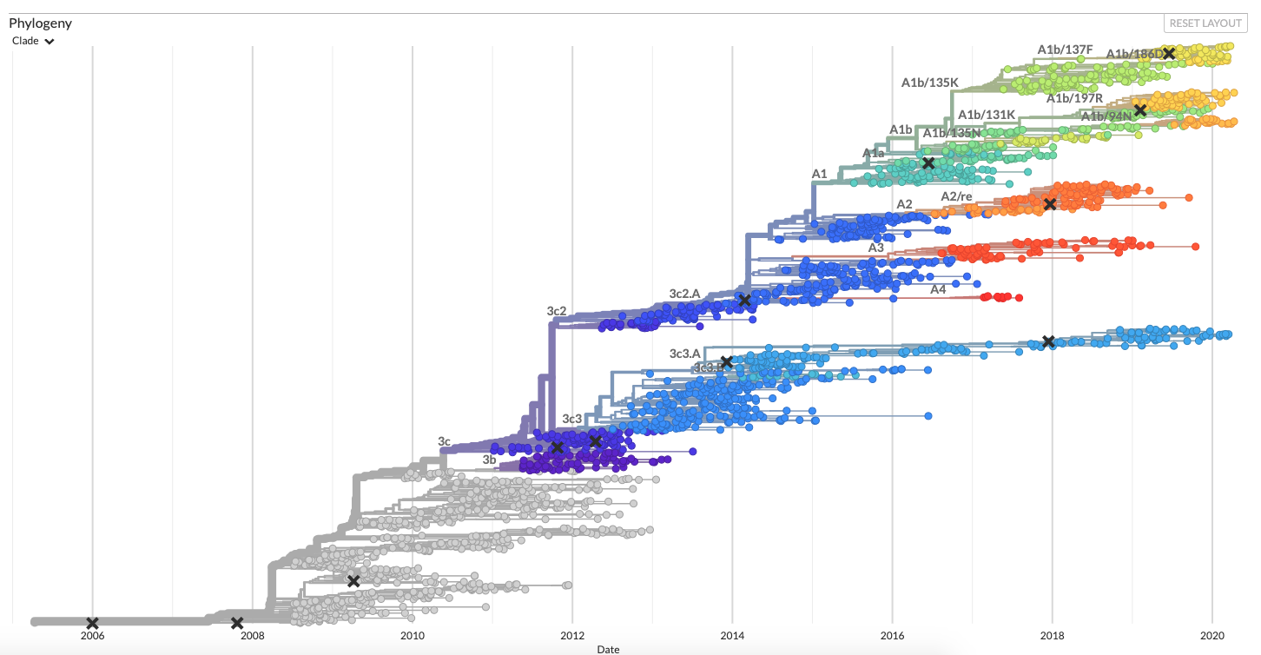
Molecular clocks bring us from divergence trees to time trees
nextstrain.com
Notes:
Clock models essentially denote functions that map genetic distance into real time.
Clock models allow us to get to time trees where branch lengths denote real time.

Slide 22
What is my clock rate? (from Holmes et al. 2016
Mutation rate (short term, faster): Error rate in replication.
Substitution rate (long term, slower): Long term rate of evolution.
Evolutionary rate (=clock rate): Measured rate of change. Result of mutation rate and population processes, such as selection. Typically sits between the mutation and substitution rate (The notation in BEAST is confusing with regards to what is what).

Slide 23
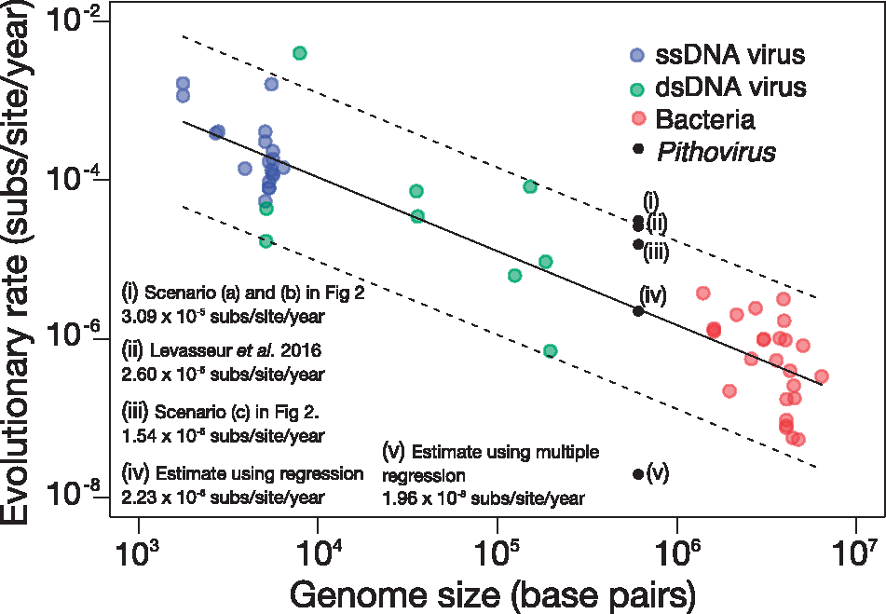
Different organisms have vastly different rates of evolution
Duchene et al., 2018, Virus Evol

Slide 24
Mathematically clock models are functions that have divergence as input and time as output
Strict clock models assume that evolution happens equally fast on each branch of a tree. Strict clocks are mostly used to study pathogens over rather short times (a few years)
Random clock models allow different branches of a phylogenetic tree to have different rates (speed) of evolution. These are more prevalent when analyzing datasets that were sampled over longer time periods

Slide 25



Mathematically clock models are functions that have divergence as input and time as output
Strict Clock:
All Branches evolve equally fast.
Local Clock:
Speed of evolution can change at estimated points in time.
Uncorrelated Clock:
Each branch evolves at a speed that is a random draw from a distribution.

Slide 26
Local clocks allow for clock range to change at pre specified points
Drummond et al., 2010, BMC
Notes:
Local clocks estimate when clock rates change.
Clock rates are always inherited from the parent lineage, unless there is a rate shift.
In practice, convergence can be an issue with local clock models.

Slide 27
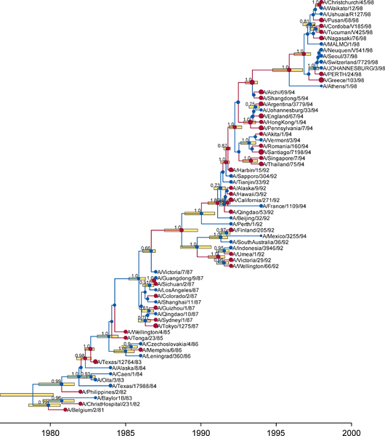
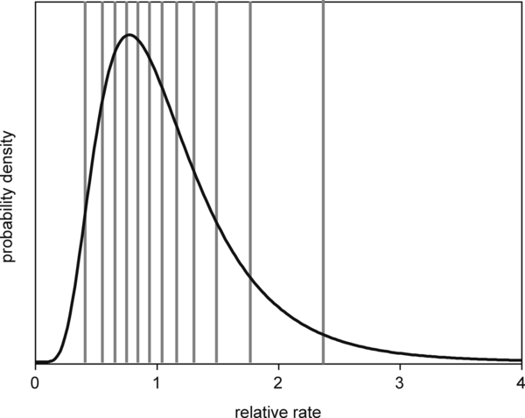
Uncorrelated clocks assume each branch evolve with a rate that is a random draw from a distribution
Drummond et al., 2006, PLoS B.
Notes:
Uncorrelated clocks assume that the clock rate of each individual branch is a random draw from some distribution.
In BEAST2, this distribution is either an exponential distribution or a lognormal one.
For the lognormal case, the width of the distribution from which the clock rate of each branch is drawn is a parameter that is estimated.

Slide 28
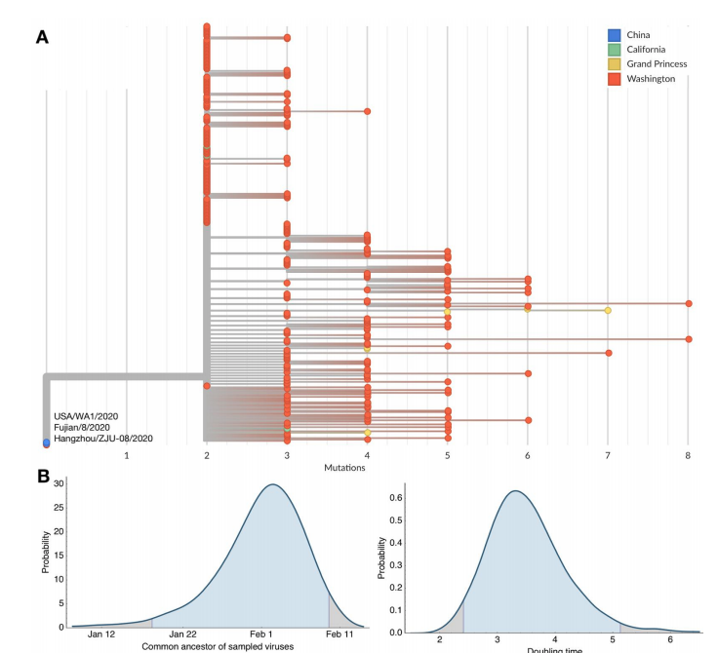
Evolutionary models can be used to estimate common ancestor times
Bedford et al., 2020, BioRxiv
Notes:
Mapping into real time allows to infer when set of sequences last shared a common ancestor.
This is an example of SARS-CoV-2 sequences from Washington State where after an initial case, later sequences are inferred to have shared a common ancestor sometime around February first.

Slide 29
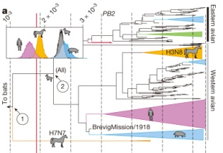
Viruses can have different evolutionary rates depending on the host
Worobey et al., 2014, Nature
Notes:
Rates of evolution do not only depend on the pathogen, but also on the host.
In this example, the evolutionary rate fo the PB2 segment of influenza viruses is estimated to evolve slower in humans and equines compared to birds and pigs/

Slide 30
Over long time windows, there is a clear relationship between divergence and time
nextstrain.com

Slide 31
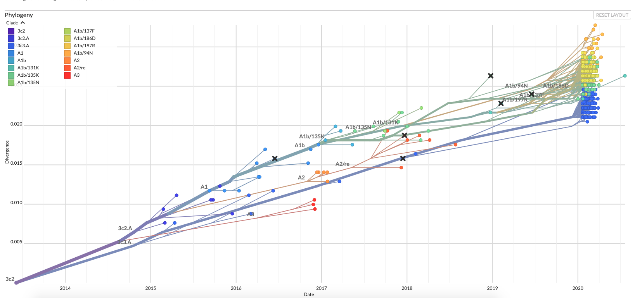
Over shorter time windows, this might, however, not be the case
nextstrain.com

Slide 32
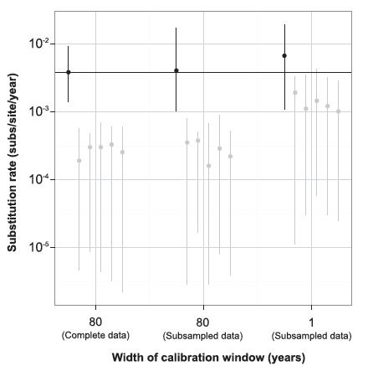
Is there enough signal to estimate evolutionary rates? Tip Randomization
Duchene et al., 2015a, MBE
Notes:
Tip date randomization can be used to see if there actually is time signal in the data.
The idea is that if we use random tip dates, what is the estimate for the clock rate.
If there is signal in the data, the clock rate estimates for the true tip dates should be substantially different (higher) from the estimates using random tip dates.

Slide 33
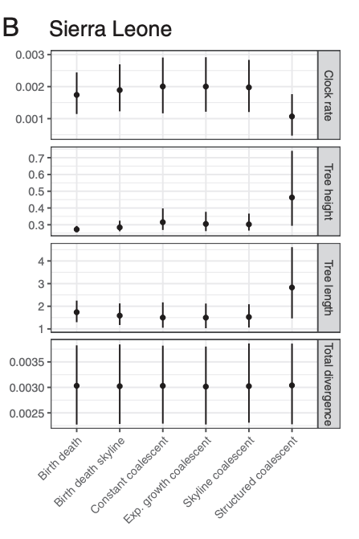
Model choices not directly related to clock models can impact rate estimates
Möller et al., 2018, PNAS
Notes:
In Bayesian phylogenetics, everything impacts everything else.
Tree priors, which we will cover tomorrow in more detail, can for example put more or less weight on some branch lengths.
This can in turn influence rate estimates

Slide 34
QUESTIONS?

Slide 35
Some reading material
Accounting for codon positions: https://doi.org/10.1093/molbev/msj021
Overfitting site models is ok: https://www.nature.com/articles/s41467-019-08822-w
Posterior predictive simulations to evaluate clock signal: https://academic.oup.com/mbe/article/32/11/2986/981260
Time randomization to evaluate clock signal: https://academic.oup.com/mbe/article/32/7/1895/1016979
Rates of evolution in EBOV: https://www.nature.com/articles/nature19790

